Slide 1
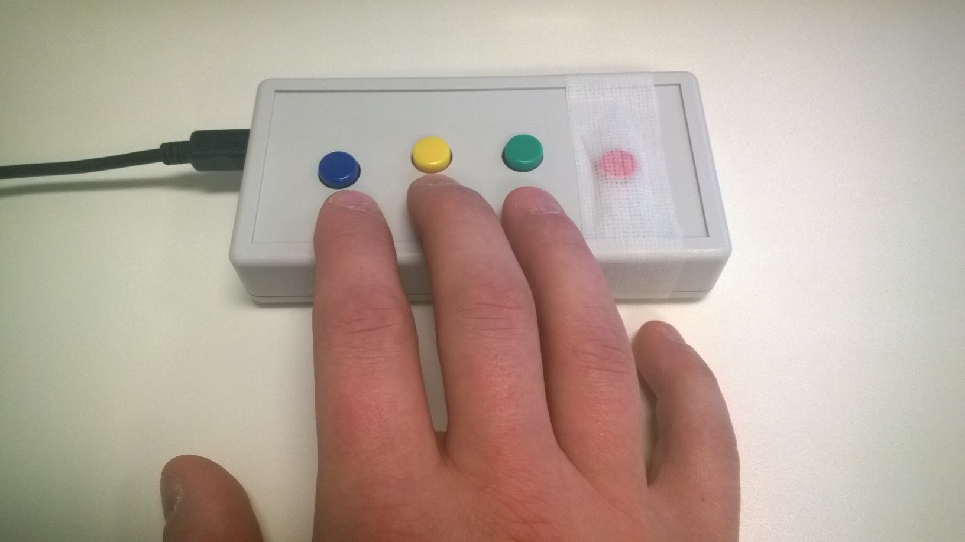
PRACTICE INSIDE SCANNER
In the Response Box you have in your hand, each key represents a number starting from 1 under your index finger.
1
2
3
4
PRESS THE NUMBER 1 BUTTON TO CONTINUE
Notes:
Outside the scanner

Slide 2
PRESS NUMBER 2
1
2
3
4

Slide 3
CORRECT!

Slide 4
PRESS NUMBER 4
1
2
3
4

Slide 5
CORRECT!

Slide 6
PRESS NUMBER 3
1
2
3
4

Slide 7
CORRECT!

Slide 8
Now, please see the picture in the next page and answer to a question
1
2
3
4
PRESS THE NUMBER 3 BUTTON TO GO TO THE NEXT PAGE

Slide 9
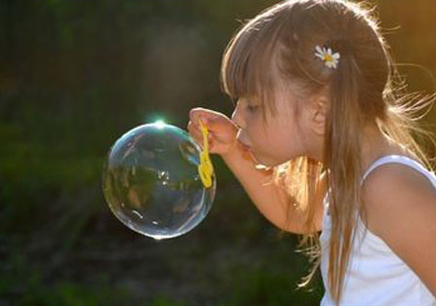
Notes:
Picture for 5 seconds

Slide 10
Now, answer to this question
Notes:
Question on Craving 1-4

Slide 11
Now, Please see following pictures and press number 1 (index finger) for any picture that has a yellow frame around it.

Slide 12
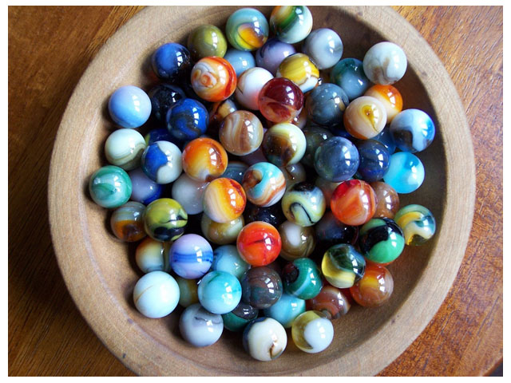
Notes:
Picture without frame

Slide 13
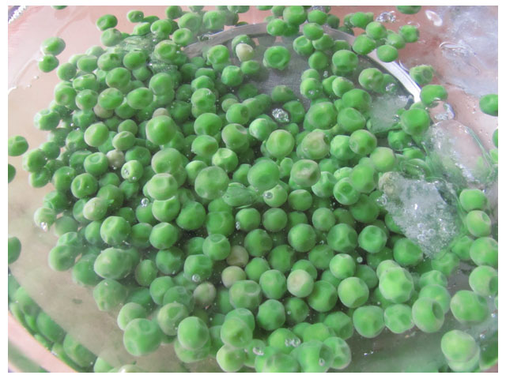
Notes:
Picture with frame

Slide 14
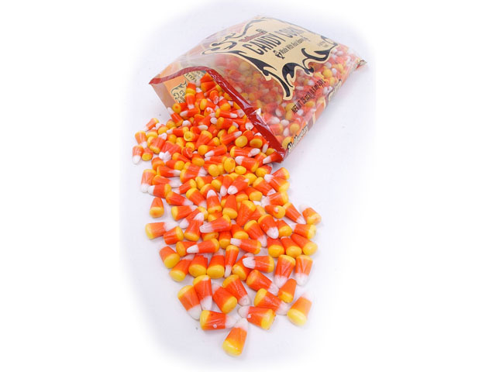
Notes:
Picture without frame

Slide 15
Great!
Now, you are ready to do the REAL task.

